Slide 1
Qvest Reading Momentum POC
By: Gustavo Franco
Name
Department Course Number Section Time Location
DATE
A demo‑ready, agentic library recommender for school librarians.

Slide 2
Name
Department Course Number Section Time Location
DATE
Problem
Exec Summary
Demo
System Overview
Architecture
Risk and Mitigations
Roadmap
FAQs

Slide 3

Problem
Name
Department Course Number Section Time Location
DATE
- Librarians need fast, trustworthy recommendations
- Student profiles do not exist
- Inventory, holds, and feedback are siloed
- Hard to explain why a book was suggested
There is a desire to provide support to a school district to increase the number of books that the students are reading. The students would read books that were recommended by the librarian, and they usually relied on anecdotal data about other children enjoying books based on what they read previously.
Books

Slide 4
Executive Summary
Name
Department Course Number Section Time Location
DATE
Outline
QRM is a demo‑ready, agentic library recommender for a school district. It combines deterministic recommendation logic (co‑borrowing similarity) with a tool‑augmented “agent” layer that can answer librarian questions, fetch reading history, place holds, and generate onboarding profiles—all while staying explainable and predictable.
The demo focuses on trust, transparency, and usability: recommendations have clear reasons, actions are logged, and the UI includes an observability trace.

Slide 5

Demo
Name
Department Course Number Section Time Location
DATE
Core capabilities
Personalized recommendations using borrowing history
Clear, human-readable explanations
Agent-assisted librarian workflows:
  Availability checks
  Reading history summaries
  Onboarding profiles
  Hold placement
  Feedback capture
  Collection gap analysis
Design principle
AI assists decisions — it does not obscure them
Notes:
Live demo flow
Select a student
Generate recommendations
Explain why each book appears
Check availability and place a hold
Capture librarian feedback
Inspect the observability trace

Slide 6
System Overview
Name
Department Course Number Section Time Location
DATE
Tech
Flow
Technology stack
Frontend: Static React-style UI
Backend: FastAPI (Python)
Data: CSV catalog, students, loans
State: JSON-based agent state, chat memory
AI: Deterministic recommender + optional LLM
Key point
Lightweight, portable, reproducible
High-level flow
UI → FastAPI → Agent Engine
Agent Engine → Tools + Recommender
Optional LLM for language refinement
State + observability recorded for every run
.

Slide 7
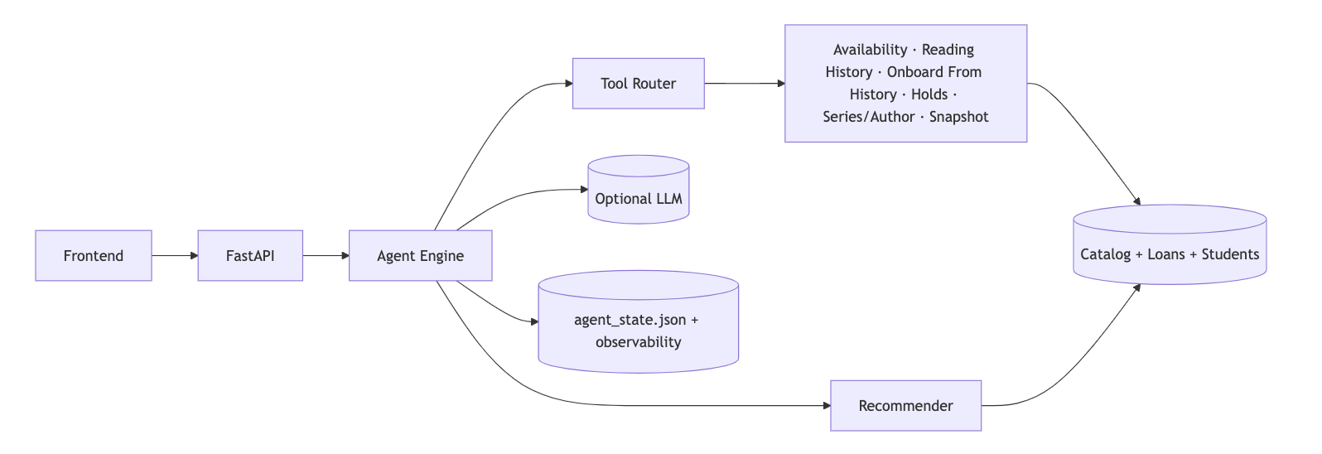
Architecture
Name
Department Course Number Section Time Location
DATE

Slide 8
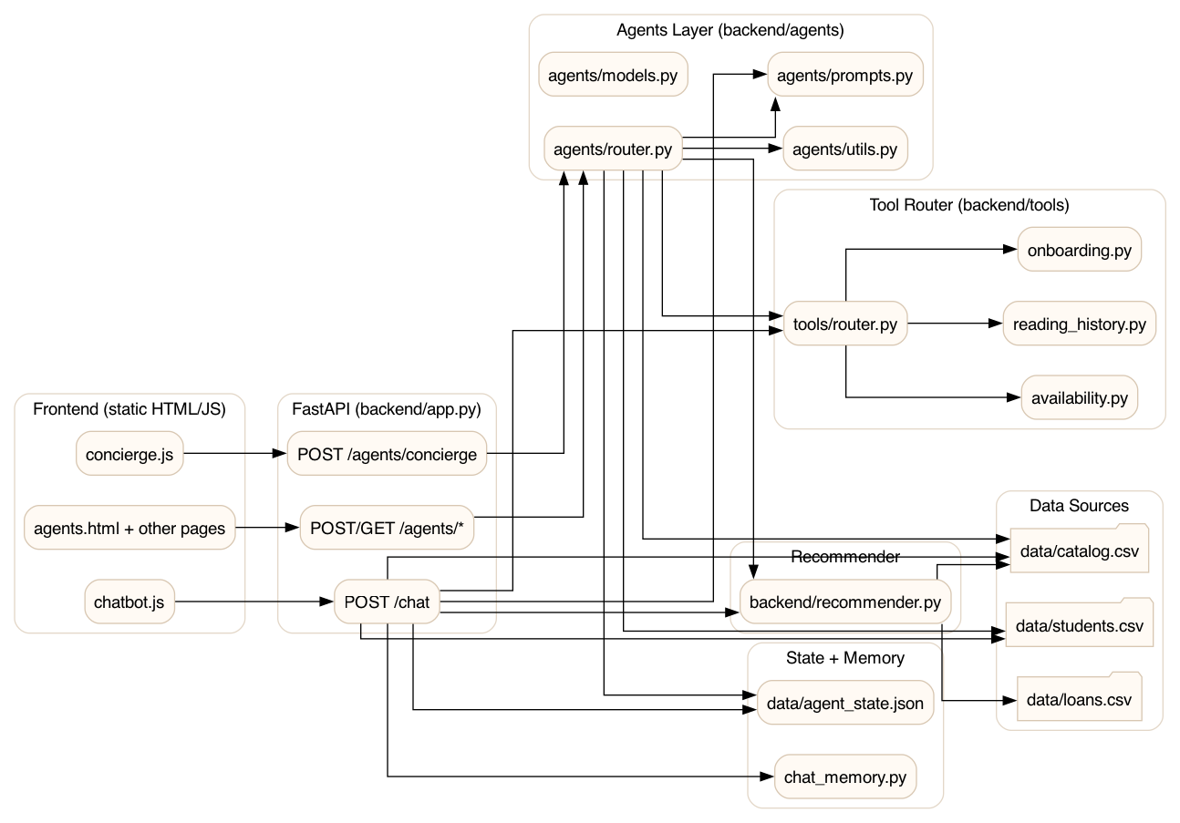
Agentic Architecture
Name
Department Course Number Section Time Location
DATE

Slide 9
Risks & Mitigations
Name
Department Course Number Section Time Location
DATE
-Deterministic fallback logic
-Observability + explainability
-Tool-based agents only
-Guardrails + non-authoritative use
-Librarian-first UX
OST
-Incomplete data
-Trust concerns
-Over-automation
-LLM hallucination
-Adoption resistance
-Deterministic in nature
-LLM integration is small
-LLMs can be bypassed unless explicitly needed

Slide 10
Schedule
Name
Department Course Number Section Time Location
DATE
Timeline
Topic
Homework
Monday
Data and Alignment:
Data audit
Privacy & compliance review
Architecture confirmation & risk assessment
Weeks
4-6
Monday
Recommender and Evaluation:
Monday
Co-borrowing similarity implementation
Evaluation against baseline heuristics
Explainability signal extraction
May
Weeks
4-5
4-5
Monday
Monday
Agent Engine & Tools:
Intent detection policies
Tool registry and routing
Guardrail enforcement
Observability event schema
May
Weeks
3-4
3-4
Monday
UI & Experience:
Monday
Monday
Librarian concierge UI
Onboarding flows
Availability + holds
May
May
Weeks
4-6
4-6
4-5

Slide 11
Roadmap & Rollout Plan
Name
Department Course Number Section Time Location
DATE
Discovery (2–3 weeks)
Data validation
Privacy review
Librarian workshops
Pilot (4–6 weeks)
Two schools
Weekly feedback loops
District rollout (6–8 weeks)
Train-the-trainer
Dashboards and outcomes tracking
Add evaluations and scripted demo flows
Expand recommendation signals
Integrate live catalog data
Add multi-school dashboards
Add individual profiles for librarians and students (IAM)
Harden guardrails and policy controls

Slide 12
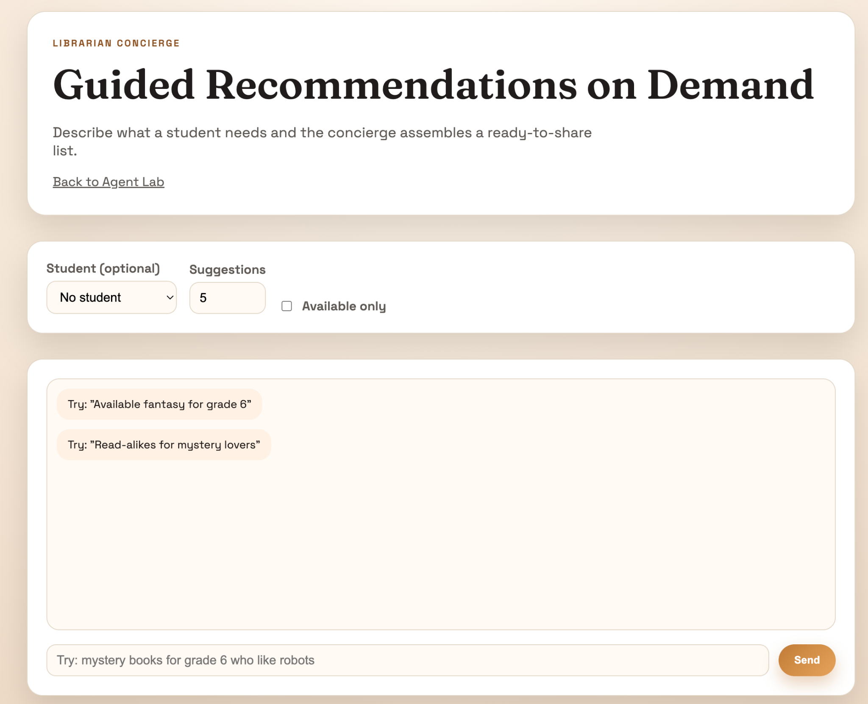
FAQs
Name
Department Course Number Section Time Location
DATE
Why didn’t you just use an LLM for recommendations?
What are the biggest operational risks?
I treated the recommender as a decision system and the LLM as a communication system. [Trust]
Data drift, trust erosion and over automation.
What would you change if this were production?
What happens when data is missing or wrong?
Keep the architecture, not the implementation. Use IAM roles and vector DB for a hybrid approach.
We assume data will be incomplete or wrong. The system is designed to fail safely, visibly, and reversibly.
What keeps this from becoming expensive?
What’s the core idea here?
Tool-first design avoids LLM calls and we can cache recommendations
The core idea is that AI earns trust by being explainable, bounded, and observable.

Slide 13

Questions
Name
Department Course Number Section Time Location
DATE

